Slide 1
Unit 2 Entity Relationship Model

Slide 2
Entity–relationship model (ER model)
An Entity–relationship model (ER model) describes the structure of a database with the help of a diagram, which is known as Entity Relationship Diagram (ER Diagram).
An ER model is a design or blueprint of a database that can later be implemented as a database. The main components of E-R model are: entity set and relationship set.

Slide 3
Entity–relationship model (ER model)
An ER diagram shows the relationship among entity sets. An entity set is a group of similar entities and these entities can have attributes. In terms of DBMS, an entity is a table or attribute of a table in database, so by showing relationship among tables and their attributes, ER diagram shows the complete logical structure of a database.
Lets have a look at a simple ER diagram to understand this concept.

Slide 4
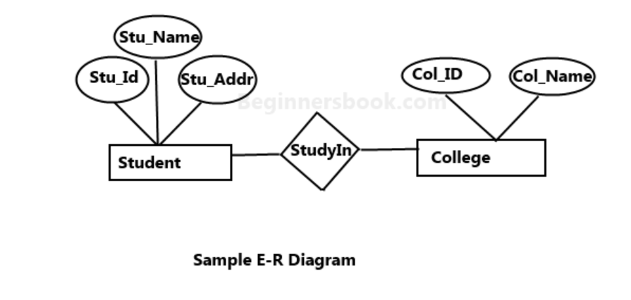
A simple ER Diagram:

Slide 5
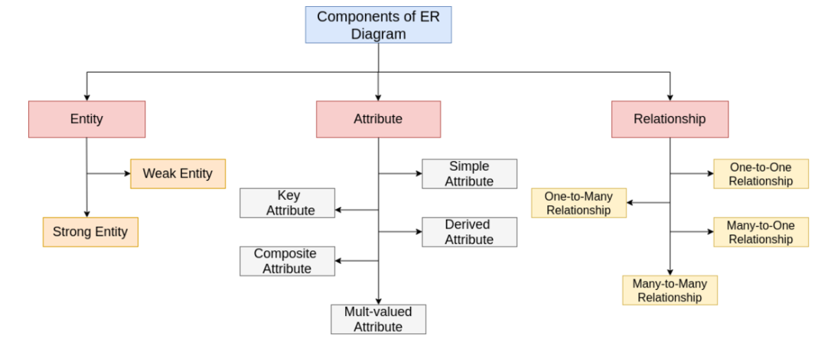
Components of a ER Diagram

Slide 6

Entity
An entity can be a real-world object either living or non-living like a person, place, concept, event. In the Entity-Relationship diagram, the entity is denoted by the rectangle box. All the entities have their properties which are called attributes in DBMS.
Example:

Slide 7
Example:
Following are the various examples of entity:
'Student' can be an entity,
'Employee' can be an entity,
'Account' can be an entity,
'Hospital' can be an entity,
'Account' can be an entity,
'Car' can be an entity,
‘Registration’ can be an entity, etc.
Note: In the database table, each tuple is an entity.

Slide 8
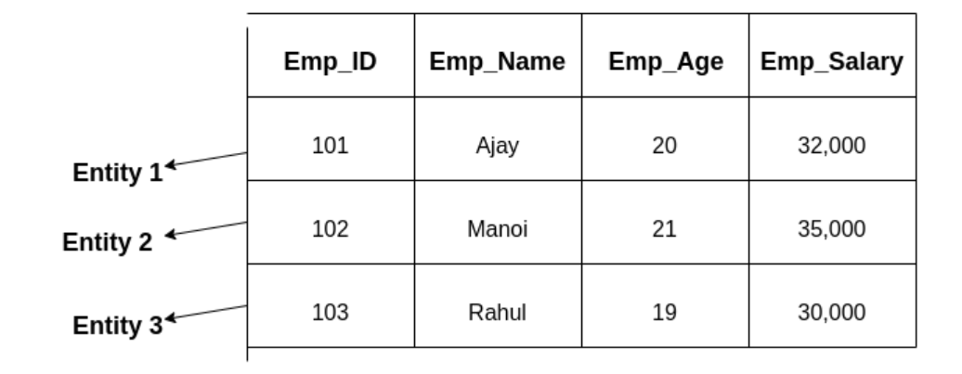
Example of entity:
For example, if we have an employee table, then each employee in that table is an entity. And, each employee is identified by the Employee_Id.

Slide 9
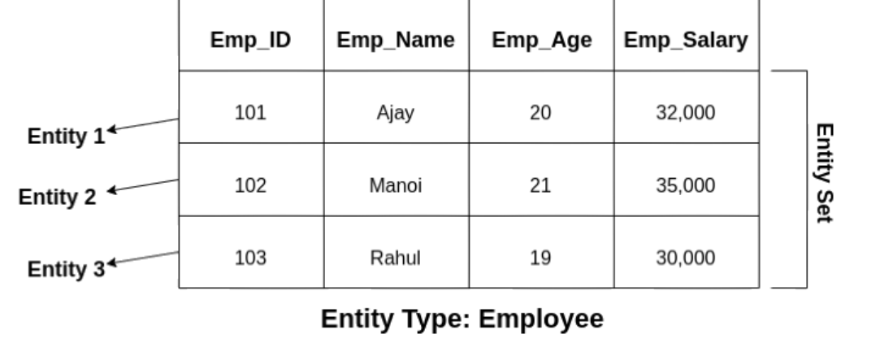
Example of Entity set:
Entity Set

Slide 10
Types of Entity:
Following are the two different types of entity:
Weak Entity
Strong Entity

Slide 11
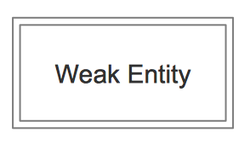
Weak Entity
A Weak entity is that entity which does not contain key attribute and depends on the strong entity via the foreign key. It is identified by some other strong entity using an identifying relationship.
In the Entity-Relationship diagram, a weak entity is represented by the double rectangle box.

Slide 12
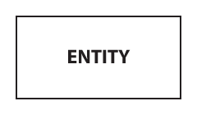
Strong Entity
A Strong entity is that entity that contains a primary key attribute. This type of entity uniquely identifies its every record using the key attribute.
In the Entity-Relationship diagram, a strong entity is represented by the single rectangle box.

Slide 13
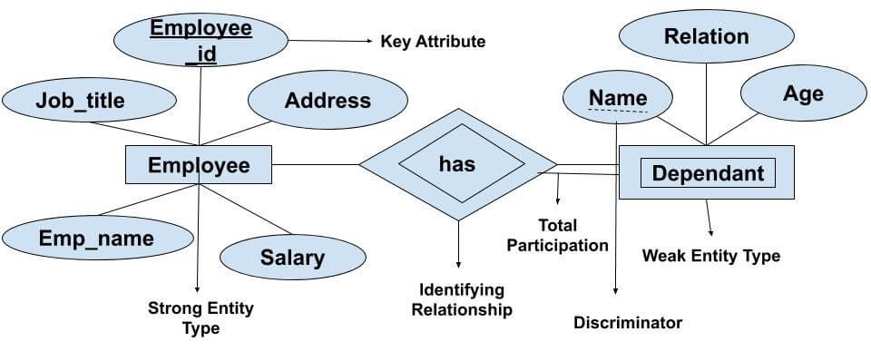
Example of relation between strong and weak entity

Slide 14
Attribute
An Attribute is a component which shows the properties or characteristics of an entity in the entity-relationship model. we can also assign the domain or range to the attribute.
In the entity-relationship diagram, attributes are represented by an oval or ellipse shape. In each diagram, every oval shape represents an attribute which is directly connected to an entity.

Slide 15
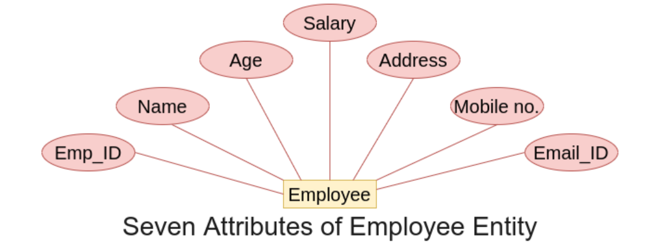
Example of Attribute

Slide 16
Types of Attribute:
Following are the different types of attribute in the er model:
Simple Attribute
Key Attribute
Derived Attribute
Composite Attribute
Multi-valued Attribute

Slide 17
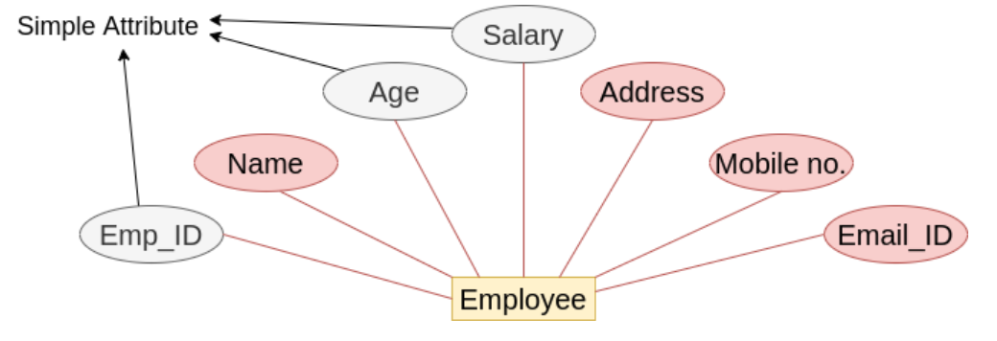
Simple Attribute
Simple attributes are those attributes of an entity, which cannot be divided further into smaller components.
Following are the example of a simple attribute:
Roll no of the Student can be a simple attribute,
Id of the Employee can be a simple attribute,
Salary of the Employee can be a simple attribute

Slide 18
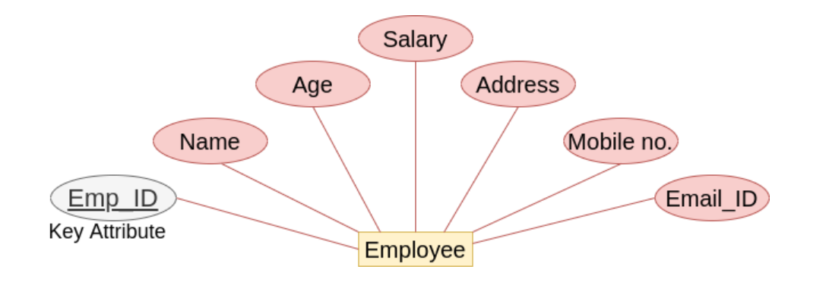
Key Attribute
Key attribute (Primary Key) is an attribute which uniquely identifies all the entities in an entity set. The values of this attribute are distinct.
In an Entity-Relationship diagram, this attribute is represented by the oval shape with the text underlined.
Following are the examples of key attribute:

Slide 19
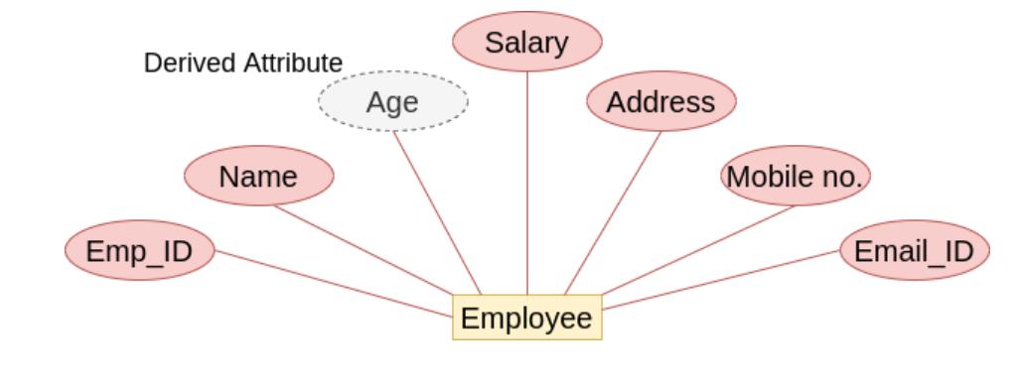
Derived Attribute
Derived Attributes are those attributes of an entity, which are based on other attributes and whose values are derived from other stored attributes.
In an Entity-Relationship diagram, this attribute is represented by the dashed oval or ellipse shape.
Following are the examples of derived attribute:
Age (Derived from Date of birth) of a student of an employee,
Total or Average Marks of a student are derived attributes, etc.

Slide 20
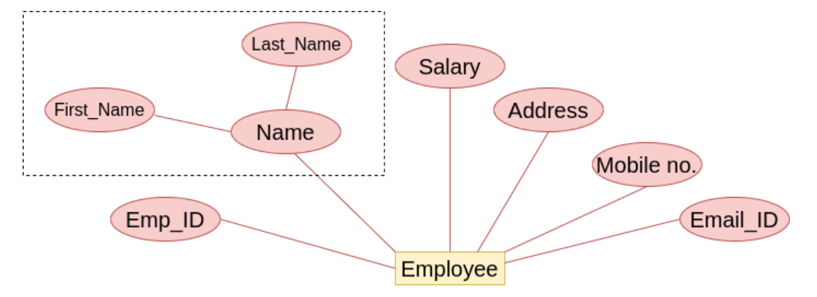
Composite Attribute
Composite Attributes are those attributes of an entity, which is a combination of more than one attributes
In the Entity-Relationship diagram, this attribute is represented by an ellipse comprising of other ellipses.
Following are the examples of composite attribute:
Address of an Employee is a composite attribute,
The name of an Employee is a composite attribute, etc.

Slide 21
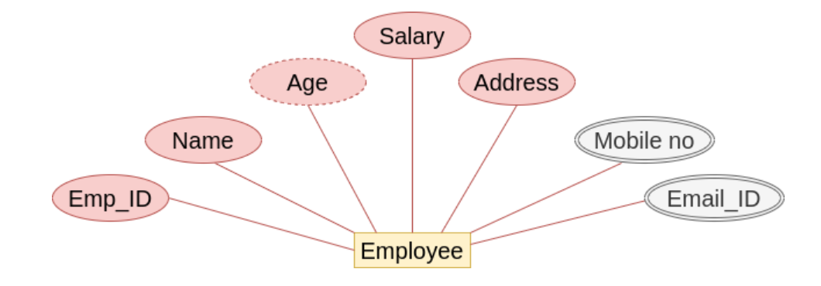
Multi-valued Attribute
Multi-valued Attributes are those attributes of an entity, which contain more than one value.
In the Entity-Relationship diagram, this attribute is represented by a double ellipse shape.
Following are the examples of multi-valued attribute:
Mobile number of the Employee is a multi-valued attribute,
Email_ID and address of the employee also be a multi-valued attribute, etc.

Slide 22
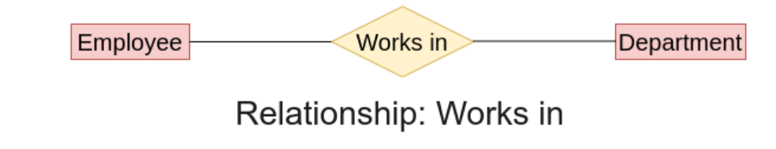
Relationship
A Relationship is also an important component of the ER model, which shows or describes the relationship between entities.
Example: In the Entity-Relationship diagram, a relationship is represented by the diamond shape.

Slide 23
Mapping Constraints/Types of Relationship
Following are the four different types of relationship in the ER model:
One-to-One Relationship
One-to-Many Relationship
Many-to-One Relationship
Many-to-Many Relationship

Slide 24
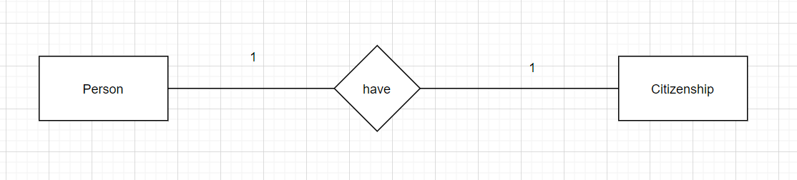
One-to-One Relationship
When one entity of the entity set P is related to a single entity of entity set Q, then this type of relation is called a one-to-one relationship.
For example, One Person have only One Citizenship number.

Slide 25
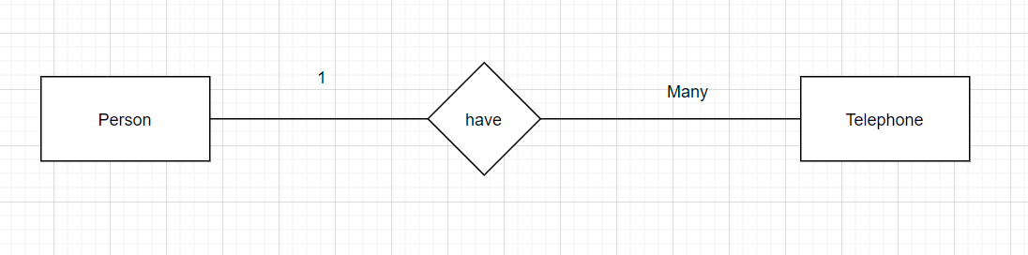
One-to-Many Relationship
When one entity of the entity set P is related to more than one entity of entity set Q, then this type of relation is called a one-to-many relationship.
For example, One person have many telephone numbers.

Slide 26
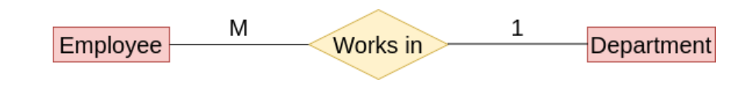
Many-to-One Relationship
When More than one entity of the entity set P is related to a single entity of entity set Q, then this type of relation is called a many-to-one relationship.
For example, More than one Employee can work in one department in an organization.

Slide 27
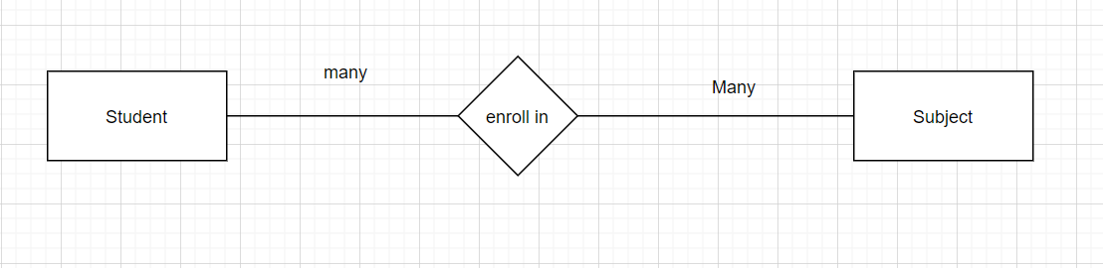
Many-to-Many Relationship
When more than one entity of the entity set P is related to more than one entity of entity set Q, then this type of relation is called a many-to-many relationship.
For example, Many Students can enroll in Many subjects.

Slide 28
Question 1:
What is ER Model? What are the components of ER-Model?

Slide 29
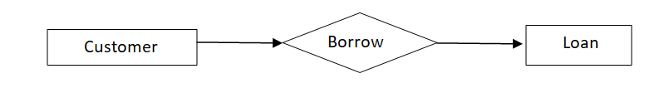
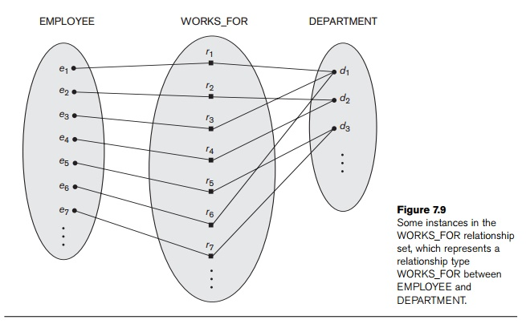
Relationship Set
A set of relationships of similar type is called a relationship set. Like entities, a relationship too can have attributes. These attributes are called descriptive attributes.

Slide 30
Role of relationship in E-R model
The main role of Relationship in E-R is to define link between the Entities
Relationship in E-R model can be represented by Diamond symbol.

Slide 31
Structural constraints of Relationship
To understand Structural constraints of Relationship, we must take a look at Cardinality Ratios and Participation Constraints.
Structural constraints are also called Structural properties of relationship in a database management system.

Slide 32
Cardinality Ratios of Relationship
Cardinality defines the number of entities in one entity set, which can be associated with the number of entities of other entity set via relationship set.
Cardinality ratio tells how many time the entity of an entity set participates in a relationship.

Slide 33
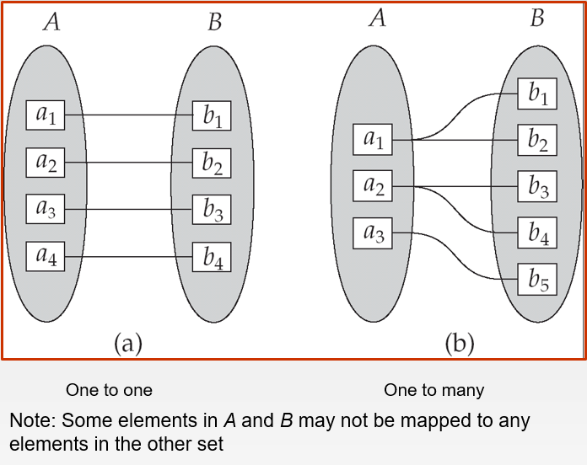
Mapping Cardinalities
is the number of entities to which another entity can be associated via a relationship. For binary relationship sets between entity sets A and B, the mapping cardinality must be one of:

Slide 34
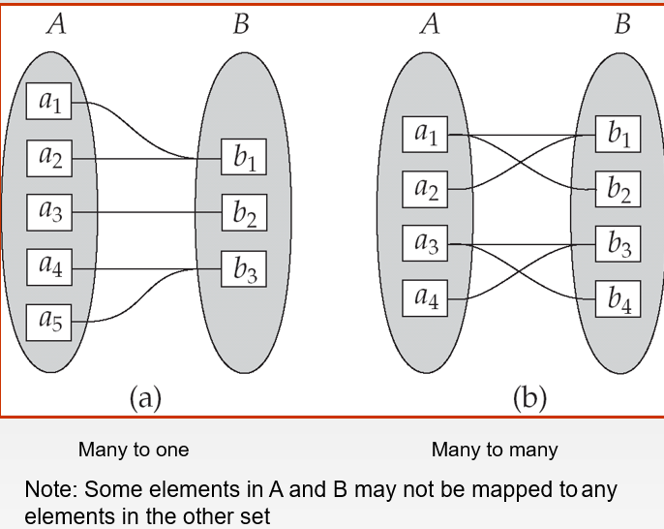
Mapping Cardinalities
For more info. :
https://www.geeksforgeeks.org/what-is-mapping-cardinalities-er-diagrams/#:~:text=Mapping%20cardinality%20is%20the%20maximum,which%20an%20entity%20can%20participate.

Slide 35
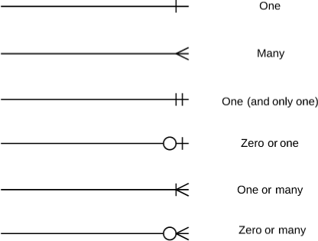
Symbols used in ER Notation:

Slide 36
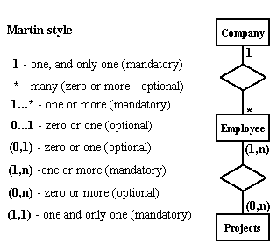
Symbols used in ER Notation:

Slide 37
Participation Constraints
Total Participation of an Entity set
Total participation of an entity set represents that each entity in entity set must have at least one relationship in a relationship set. It is also called mandatory participation. Total participation is represented using a double line between the entity set and relationship set.
Partial participation of an Entity Set
Partial participation of an entity set represents that each entity in the entity set may or may not participate in the relationship instance in that relationship set. It is also called as optional participation. Partial participation is represented using a single line between the entity set and relationship set.

Slide 38
Degree of Relationship
The degree of a relationship is the number of entity types that participate(associate) in a relationship. By seeing an E-R diagram, we can simply tell the degree of a relationship i.e the number of an entity type that is connected to a relationship is the degree of that relationship.
Unary
Binary
Ternary
N-ary
For detail info. visit :
https://afteracademy.com/blog/what-is-the-degree-of-relation-in-dbms

Slide 39
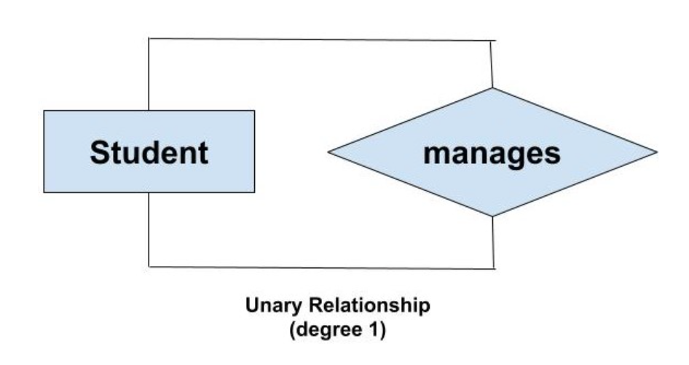
Unary (degree 1)
A unary relationship exists when both the participating entity type are the same. When such a relationship is present we say that the degree of relationship is 1.

Slide 40
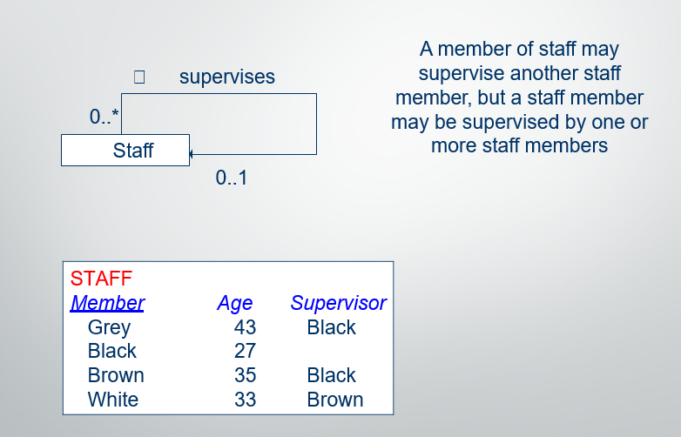
Another example of Unary:

Slide 41
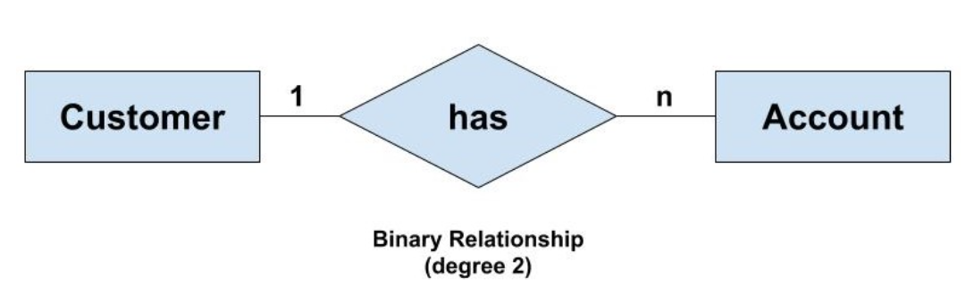
Binary (degree 2)
A binary relationship exists when exactly two entity type participates. When such a relationship is present we say that the degree is 2. This is the most common degree of relationship. It is easy to deal with such relationship as these can be easily converted into relational tables.

Slide 42
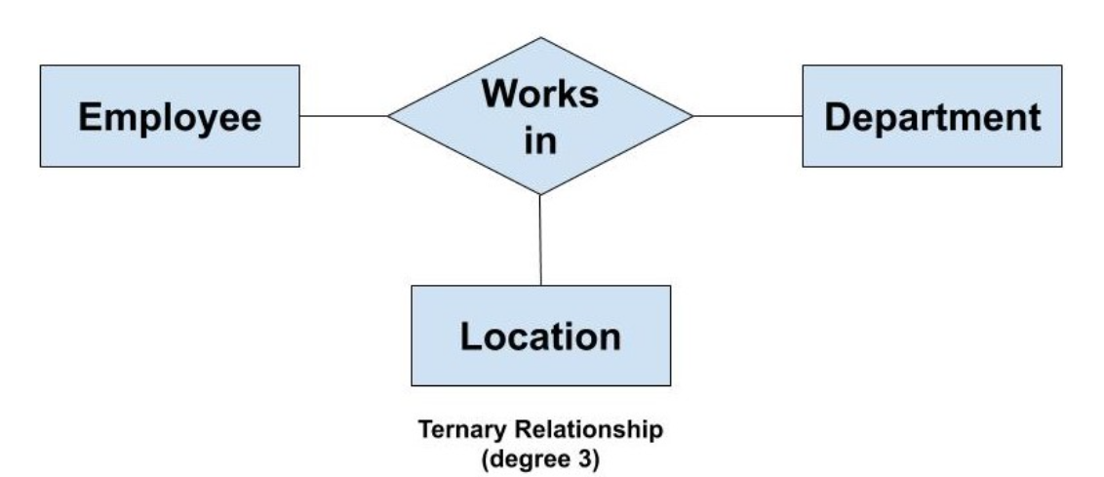
Ternary(degree 3)
A ternary relationship exists when exactly three entity type participates. When such a relationship is present we say that the degree is 3. As the number of entity increases in the relationship, it becomes complex to convert them into relational tables.

Slide 43
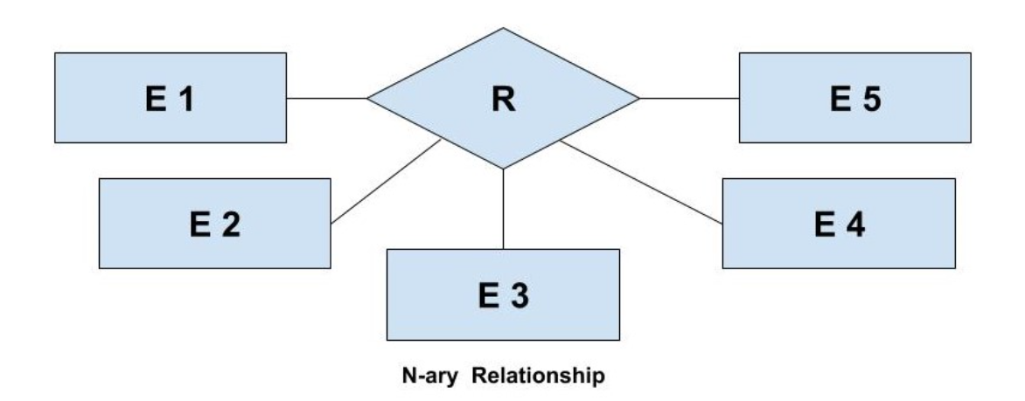
N-ary (n degree)
An N-ary relationship exists when ‘n’ number of entities are participating. So, any number of entities can participate in a relationship. There is no limitation to the maximum number of entities that can participate. But, relations with a higher degree are not common. This is because the conversion of higher degree relations to relational tables gets complex.

Slide 44
ER naming conventions
In ER diagrams, we will use the convention that entity type and relationship type names are uppercase letters, attribute names have their initial letter capitalized and role name are lowercase letters.
Choosing binary relationship names to make the ER diagram of the schema readable from left to right and from top to bottom.

Slide 45
Exercise 1:
See if you can draw an E-R diagram for this scenario !
– “A student registers for up to 8 subjects and each subjects has many students on it. Record the student ID, their full name, DOB, mobile no. and address and also each subject ID and title”. Remember to show in your model:
All primary keys,
Entities
Relationships
Attributes

Slide 46
Keys
A key in DBMS is an attribute or a set of attributes that help to uniquely identify a tuple (or row) in a relation (or table). Keys are also used to establish relationships between the different tables and columns of a relational database. Individual values in a key are called key values.
Let us take a real-life example of the database of each student studying in an engineering college.
What attribute of the student do you think will uniquely identify each of them? You could refer to a student by using their name, department, year and section. Or, you can mention only the university roll number of the student, and you can get all the other details from that.

Slide 47
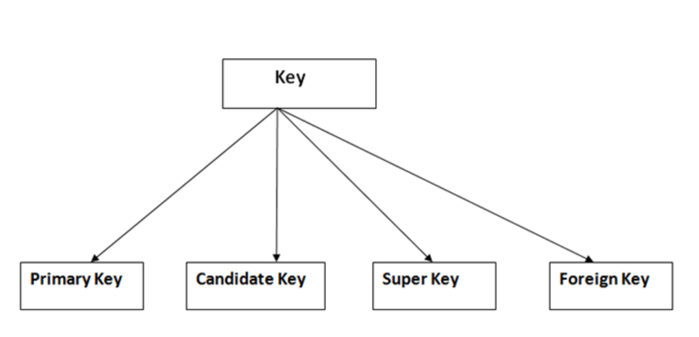
Types of Keys in DBMS
Primary Key
Foreign Key
Candidate Key
Super Key

Slide 48
Primary Key
A primary key is a column of a table that helps to identify every record present in that table uniquely. There can be only one primary Key in a table. Also, the primary Key cannot have the same values repeating for any row. Every value of the primary key has to be different with no repetitions.
The PRIMARY KEY (PK) constraint put on a column will not allow them to have any null values or any duplicates. One table can have only one primary key constraint.

Slide 49
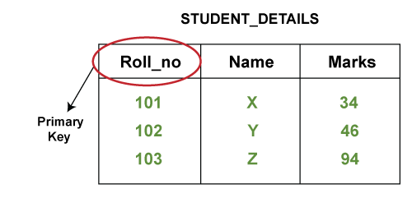
Example of primary key:

Slide 50
Foreign Key
Foreign Key is used to establish relationships between two tables. A foreign key will require each value in a column or set of columns to match the Primary Key of the referential table. Foreign keys help to maintain data and referential integrity.

Slide 51
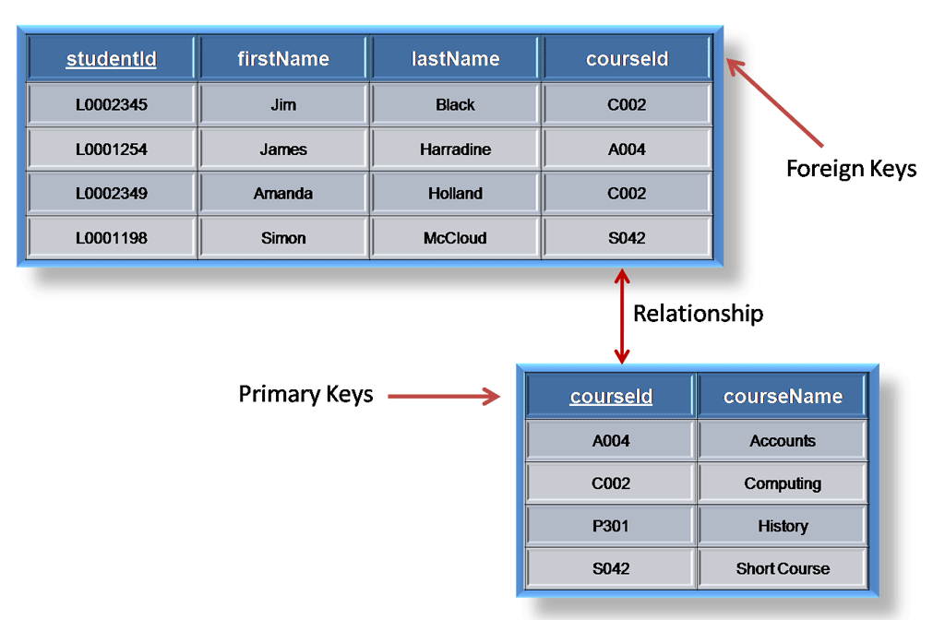
Example of foreign key:

Slide 52
Candidate Key
Candidate keys are those attributes that uniquely identify rows of a table. The Primary Key of a table is selected from one of the candidate keys. So, candidate keys have the same properties as the primary keys explained above. There can be more than one candidate keys in a table. It can have null values.

Slide 53
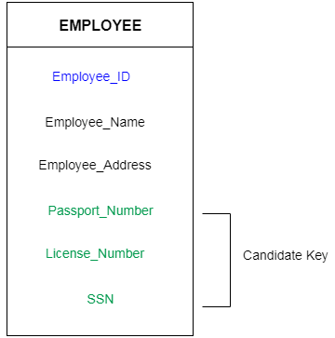
Example of Candidate key:

Slide 54
Super Key
Super Key is the set of all the keys which help to identify rows in a table uniquely. This means that all those columns of a table that is capable of identifying the other columns of that table uniquely will all be considered super keys.
It is the superset where the candidate key is a part of the super key only. So, all those attributes in a table that is capable of identifying the other attributes of the table in a unique manner are all super keys.

Slide 55
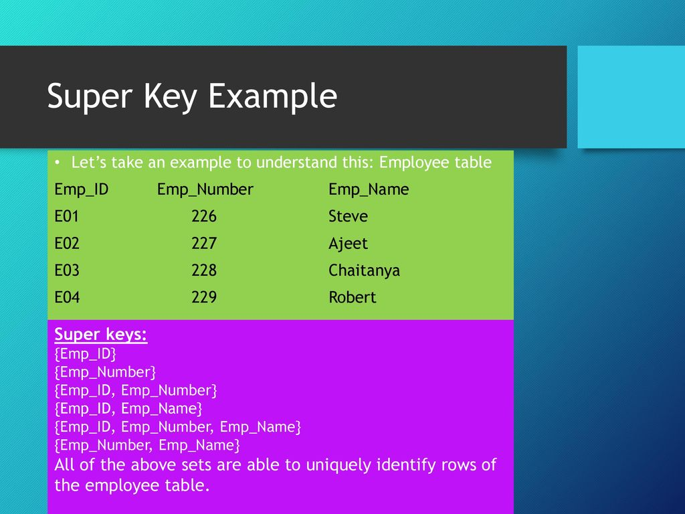
Example of Super key:

Slide 56
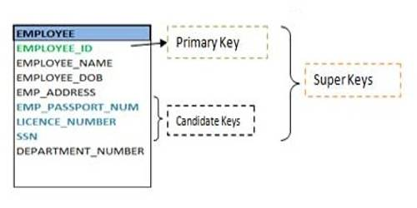

Slide 57
Question 2:
Define Primary key, Foreign key, Candidate key and Super key.

Slide 58
Extended or Enhanced ER Model
Extended ER is a high-level data model that incorporates the extensions to the original ER model. Enhanced ER models are high level models that represent the requirements and complexities of complex databases.
As the complexity of data increased in the late 1980s, it became more and more difficult to use the traditional ER Model for database modelling. Hence some improvements or enhancement were made to the existing ER Model to make it able to handle the complex application better.

Slide 59
Extended or Enhanced ER Model
Hence, as part of the Extended ER Model, along with other improvements, three new concepts were added to the existing ER Model.
Generalization
Specialization
Aggregation

Slide 60
Generalization
Generalization is the process of extracting common properties from a set of entities and create a generalized entity from it.
Generalization is a “ Bottom-up approach” in which two or more entities can be combined to form a higher level entity if they have some attribute in common.
Subclass are combined to make a superclass.

Slide 61
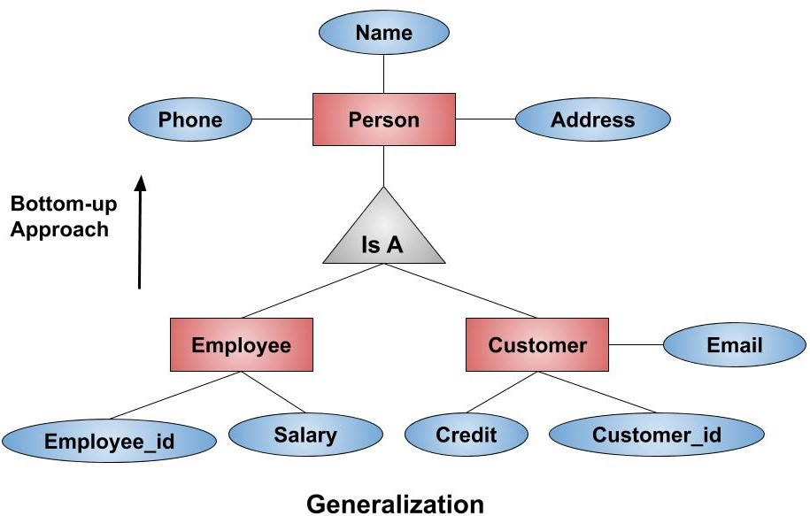
Example:
Consider we have 2 entities Employee and Customer. Now these 2 entities can be generalized into one higher entity that is Person.

Slide 62
Specialization
Specialization is opposite of Generalization.
In Specialization, an entity is broken down into sub-entities based on their characteristics.
Specialization is used to identify the subset of an entity set that shares some distinguishing characteristics.
Specialization can be repeatedly applied to refine the design by triangle component labeled IS A.

Slide 63
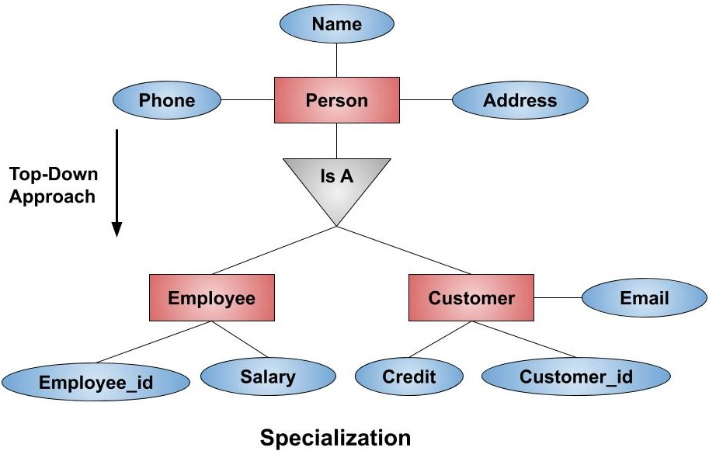
Example:
Consider we have 1 entity Person. Now this 1 entity can be specialized into 2 lower entities that is Employee and Customer.

Slide 64
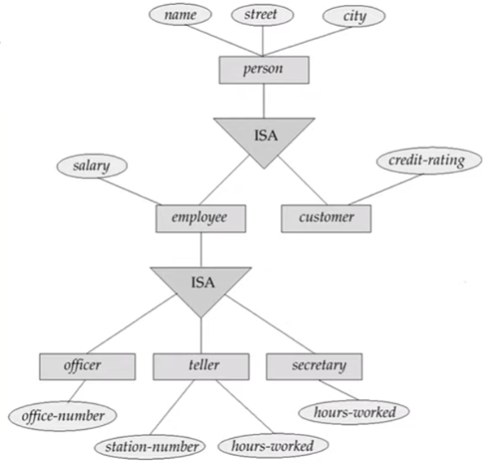
How Schema or Tables can be formed?
Note: We must always consider leaf nodes which does not have any child.
Four tables can be formed in this example:
Customer = {name, street, city, credit-rating}
Officer={name, street, city, salary, office-number}
Teller={name, street, city, salary, station-number, hours-worked}
Secretary={name, street, city, salary, Hours-worked}

Slide 65
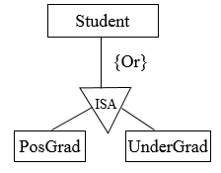
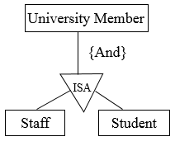
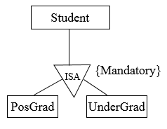
Constraints in Generalization/Specialization
Disjoint :
Disjoint is nothing but intersection, the number of instances specified for the given superclass can participate in only one of the sub classes.
Overlapping constraint:
Two or more instances of the super class are participating in two or more sub classes then it is called overlapping constraints.
E.g: A person who knows Java and PHP can participate in both teams.
Completeness constraint:
Every instance participates in a relationship. All the instances of the superclass must participate in a relationship or into the sub class

Slide 66
Aggregation
In aggregation, the relation between two entities is treated as a single entity. In aggregation, relationship with its corresponding entities is aggregated into a higher level entity.
It is a process when a relationship between 2 or more than 2 entities is considered as a single entity and again this single entity has a relationship with another entity.

Slide 67
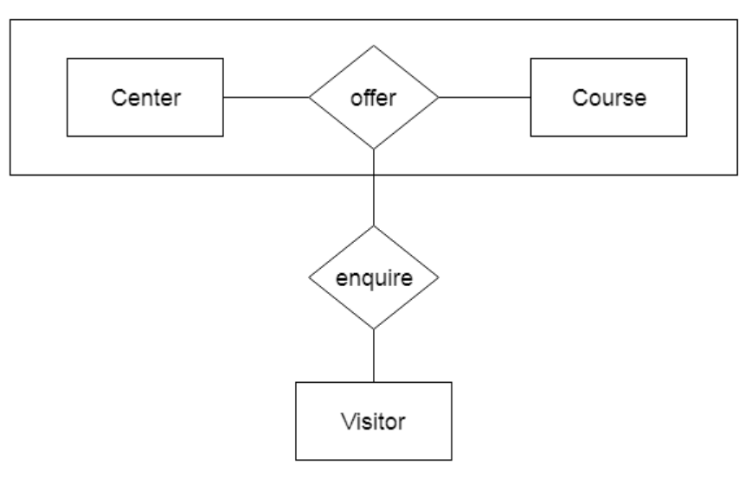
Example of Aggregation:
For example: Center entity offers the Course entity act as a single entity in the relationship which is in a relationship with another entity visitor. In the real world, if a visitor visits a coaching center then he will never enquiry about the Course only or just about the Center instead he will ask the enquiry about both.

Slide 68
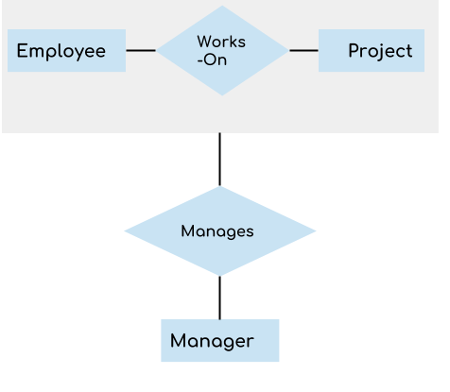
Example of Aggregation:
In real world, we know that a manager not only manages the employee working under them but he has to manage the project as well. In such scenario if entity “Manager” makes a “manages” relationship with either “Employee” or “Project” entity alone then it will not make any sense because he has to manage both. In these cases the relationship of two entities acts as one entity. In our example, the relationship “Works-On” between “Employee” & “Project” acts as one entity that has a relationship “Manages” with the entity “Manager”.

Slide 69
Question 3:
What is Extended ER Model? Explain its concepts in details.

Slide 70
Converting/Reducing ER diagram into Tables
ER diagram is converted into the tables in relational model.
This is because relational models can be easily implemented by RDBMS like MySQL , Oracle etc.

Slide 71
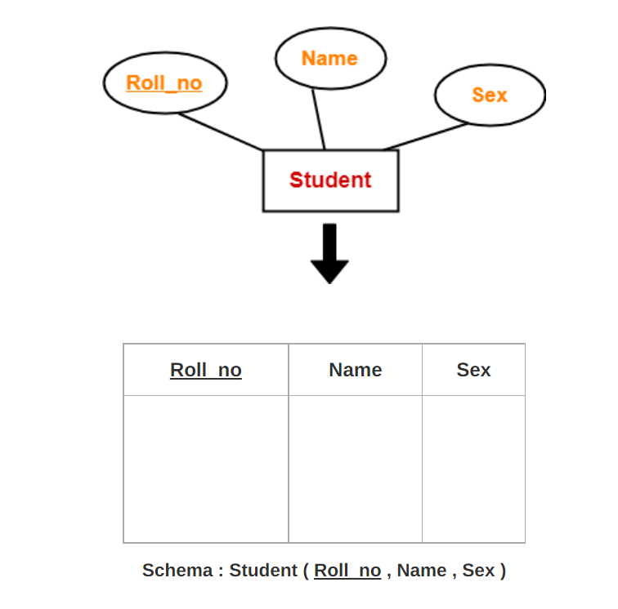
For Strong Entity Set With Only Simple Attributes
A strong entity set with only simple attributes will require only one table in relational model.
Attributes of the table will be the attributes of the entity set.
The primary key of the table will be the key attribute of the entity set.

Slide 72
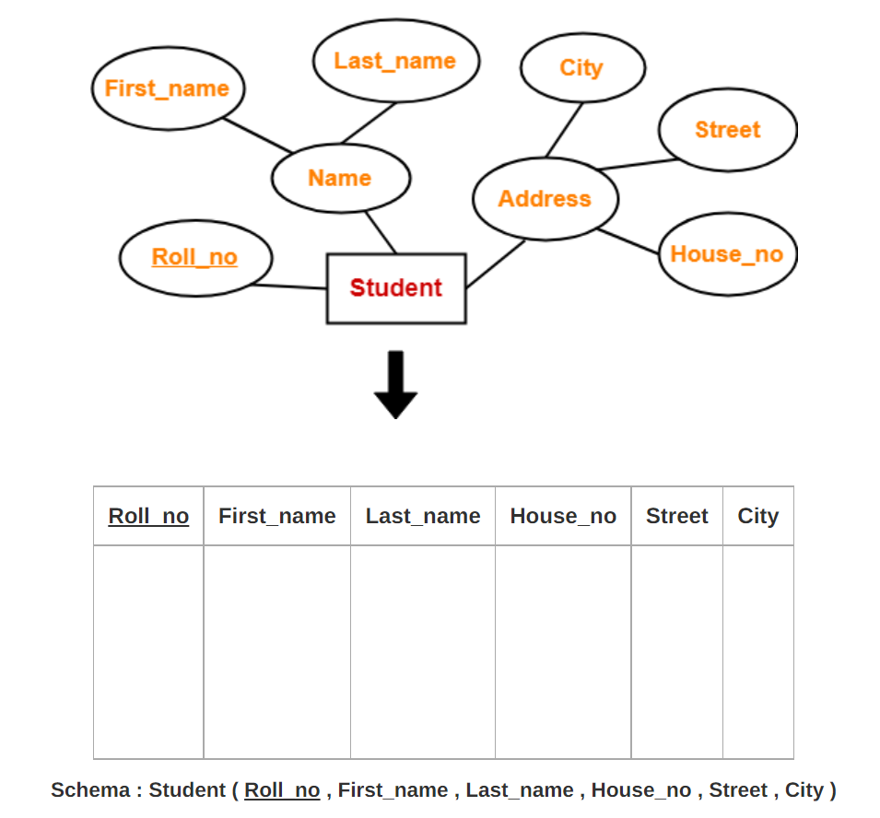
For Strong Entity Set With Composite Attributes-
A strong entity set with any number of composite attributes will require only one table in relational model.
While conversion, simple attributes of the composite attributes are taken into account and not the composite attribute itself

Slide 73
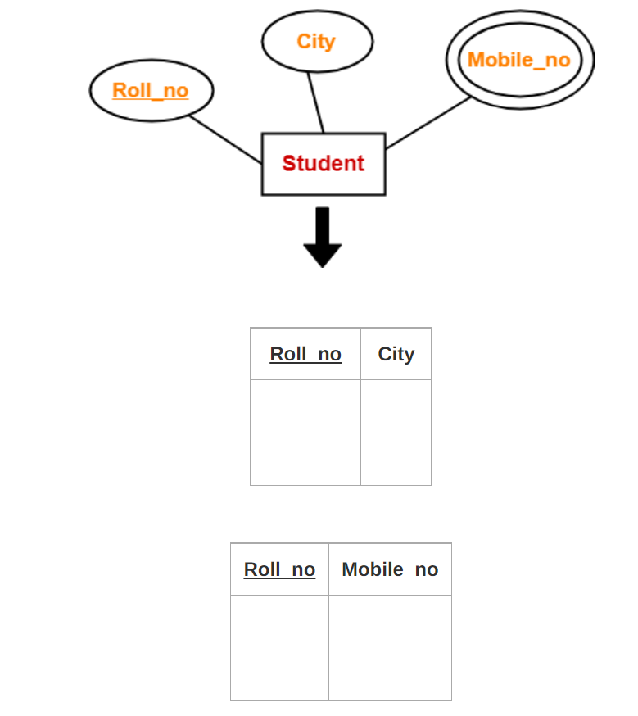
For Strong Entity Set With Multi Valued Attributes-
A strong entity set with any number of multi valued attributes will require two tables in relational model.
One table will contain all the simple attributes with the primary key.
Other table will contain the primary key and all the multi valued attributes.

Slide 74
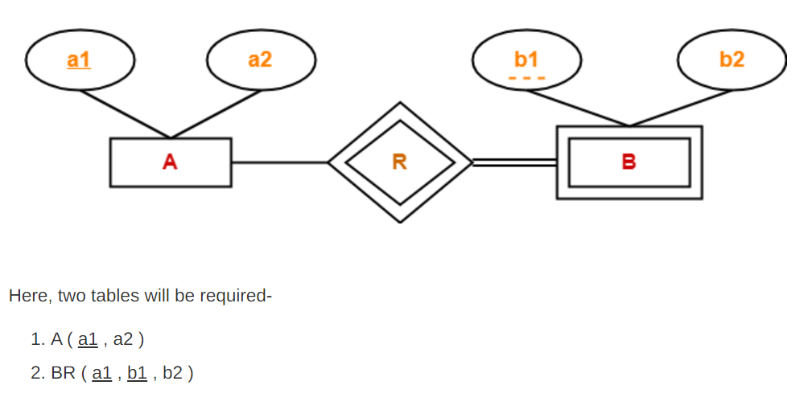
For Binary Relationship With Weak Entity Set-
Weak entity set always appears in association with identifying relationship with total participation constraint.
The foreign key in BR table which is a1 cannot be NULL.

Slide 75
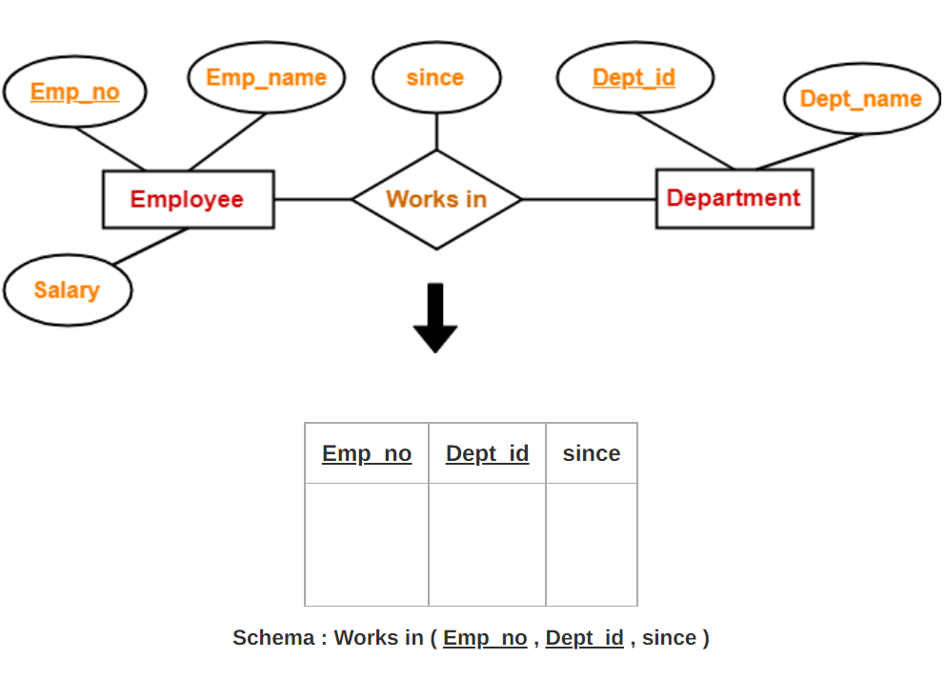
Translating Relationship Set into a Table
A relationship set will require one table in the relational model.
Attributes of the table are-
Primary key attributes of the participating entity sets
Its own descriptive attributes if any.

Slide 76
For Binary Relationships With Cardinality Ratios-
The following four cases are possible-
Case-01: Binary relationship with cardinality ratio m:n
Case-02: Binary relationship with cardinality ratio 1:n
Case-03: Binary relationship with cardinality ratio m:1
Case-04: Binary relationship with cardinality ratio 1:1

Slide 77
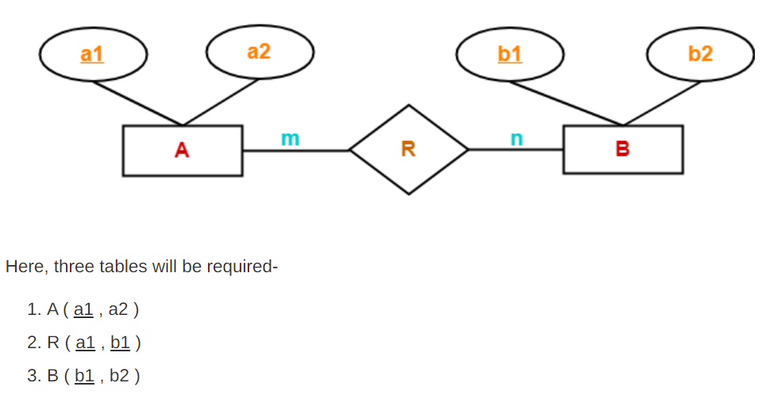
For Binary Relationship With Cardinality Ratio m:n

Slide 78
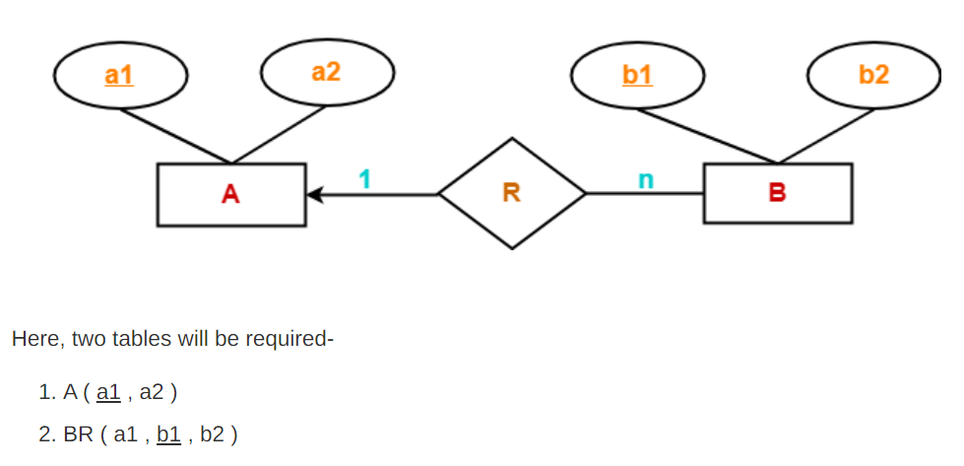
For Binary Relationship With Cardinality Ratio 1:n

Slide 79

For Binary Relationship With Cardinality Ratio m:1

Slide 80

For Binary Relationship With Cardinality Ratio 1:1
For detail info:
https://www.gatevidyalay.com/er-diagrams-to-tables/

Slide 81

Summary of Symbols Used in E-R Notation

Slide 82

Summary of Symbols Used in E-R Notation

Slide 83


Problem
Find the minimum number of tables required for the following ER diagram in relational model

Slide 84

Problem
Find the minimum number of tables required for the following ER diagram in relational model

Slide 85

Problem
Find the minimum number of tables required for the following ER diagram in relational model

Slide 86

Problem
Find the minimum number of tables required for the following ER diagram in relational model

